Slide 1
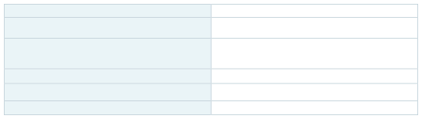

SIMATS ENGINEERING (SAVEETHA SCHOOL OF ENGINEERING) Department of Computer Science and Engineering
CO5 ASSESSMENT TOOL 1 – DEBUGGING & OPTIMIZATION CO5AT2
Course Code: Course Title:
CSA0201
C Programming
CO5 Design modular and scalable C programs using functions, recursion, pointers, and file handling.
Assessment Tool 1 – Level 1 & Viva Voce
20%
100
CO Assessed: Assessment:
Weightage:
Total Marks:
Student Name: Reg. No.: Section / Batch:
Date:
Code of Conduct
I ______________________________________________________________________________________________ (Name / Reg No) certify that this submission is my original work and that I have adhered to the guidelines specified for this assessment. I understand that any violation of academic integrity rules will result in disciplinary action.
Signature of the Student: _________________________
Instructions
•This assessment covers Level 1 and Viva Voce evaluation. Total: 100 Marks.
•Students should develop correct and well-structured logic for the given problem.
•Students should demonstrate correct syntax and semantics, consider time and space complexity, and validate
solutions using test cases.
•Students should explain their logic, code, and concepts clearly during the viva voce.
•No negative marking. Unanswered questions carry zero marks.
SIMATS ENGINEERING | Assessment Tool 1 – CO2 | C Programming

Slide 2
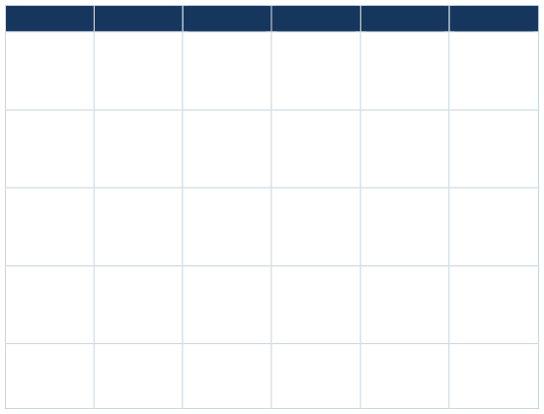

RUBRICS FOR LEVEL 1 & VIVA VOCE
Criteria
Weightage
Exemplary
Accurately identifies all errors and root causes with clear under
techniques effectively to resolve issues Uses appropriate
minor errors Limited debugging approach; requires
Unable to debug or resolve issues
Clear justification
Writes error- free code with correct syntax and semantics
Proficient
Developing
Begining
Problem
identification
20%
Identify most error with minor maps
Identify some error but misses key issues
Unable to identify error correctly
Use apoprate dubbing methods with minor mirror errors
Improve time complexity with minor mirror gaps in efficiency
Debugging
25%
Limited debbing approach
Unable to debbing or resolve issues
Optimization
Limited improvement in time complexity
No improvement identificant approach retained
20%
Analysis
20%
Show reasonable analysis justification
Limited analysis;weak reasoning
No analytical reasoning demonstrated
Code is clearly minor documentation mapps
Code lack structure and proper documentation
Parely written with no documentation
Code quantity
15%
FACULTY EVALUATION / SIGNATURE
Faculty In-charge
Signature: _______________ Date: ___________________
Course Coordinator
Signature: _______________ Date: ___________________
Program Director
Signature: _______________ Date: ___________________
SIMATS ENGINEERING | Assessment Tool 1 – CO2 | C Programming

